Slide 1
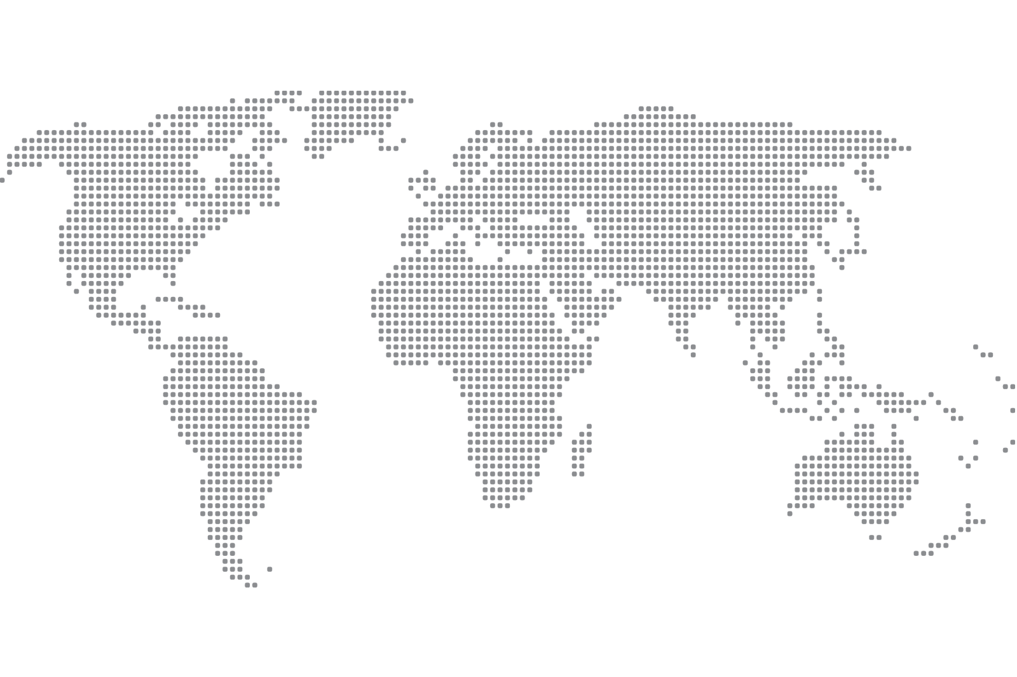
The World Report
Mikaela Pisani, Marcin Grzechowiak, Jereamy Riggs, Rogelio Valdez

Slide 2
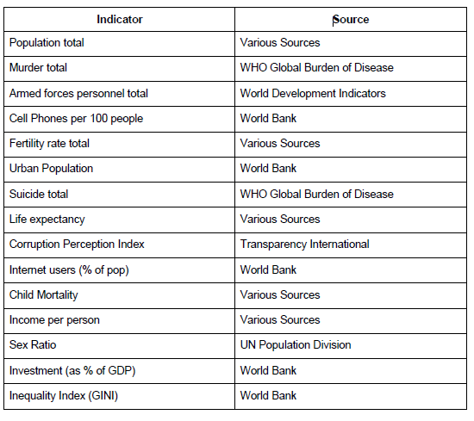
About Data

Slide 3
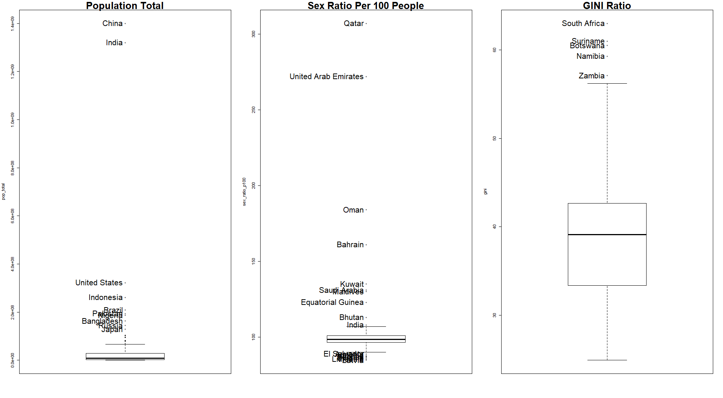
Outliers

Slide 4
Part I.
Dimension Reduction

Slide 5
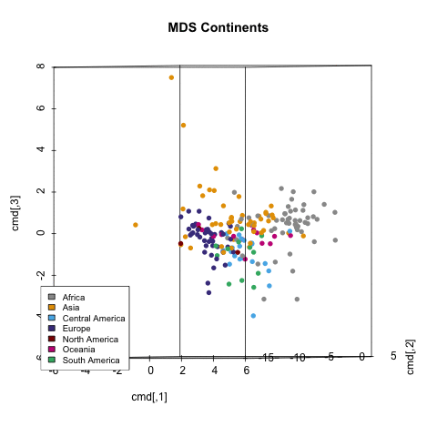
Multidimensional Scaling (MDS) Continents presented in 3D space

Slide 6
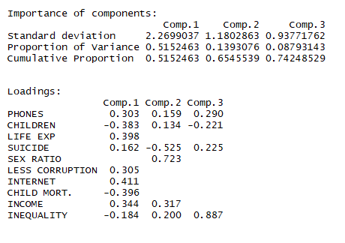
Principal Components Analysis (PCA)
PC1: highly loaded in: number of phones, life expectancy, Corruption index, Access to the Internet and Income.
PC2: highly loaded in the number of suicides and sex ratio.
PC3: meaningful in the context of inequality.

Slide 7
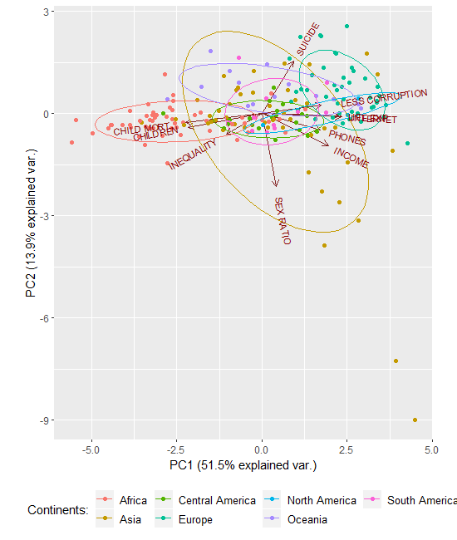
PC 1 vs. PC2

Slide 8
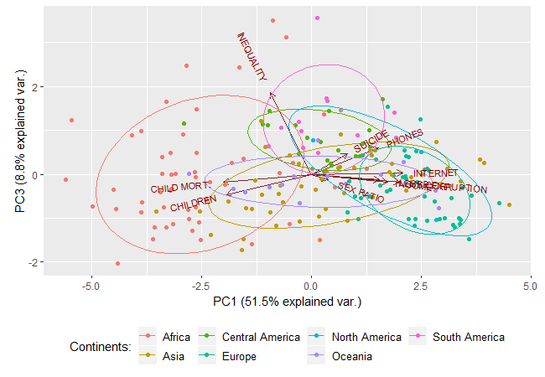
PC 1 vs. PC3

Slide 9
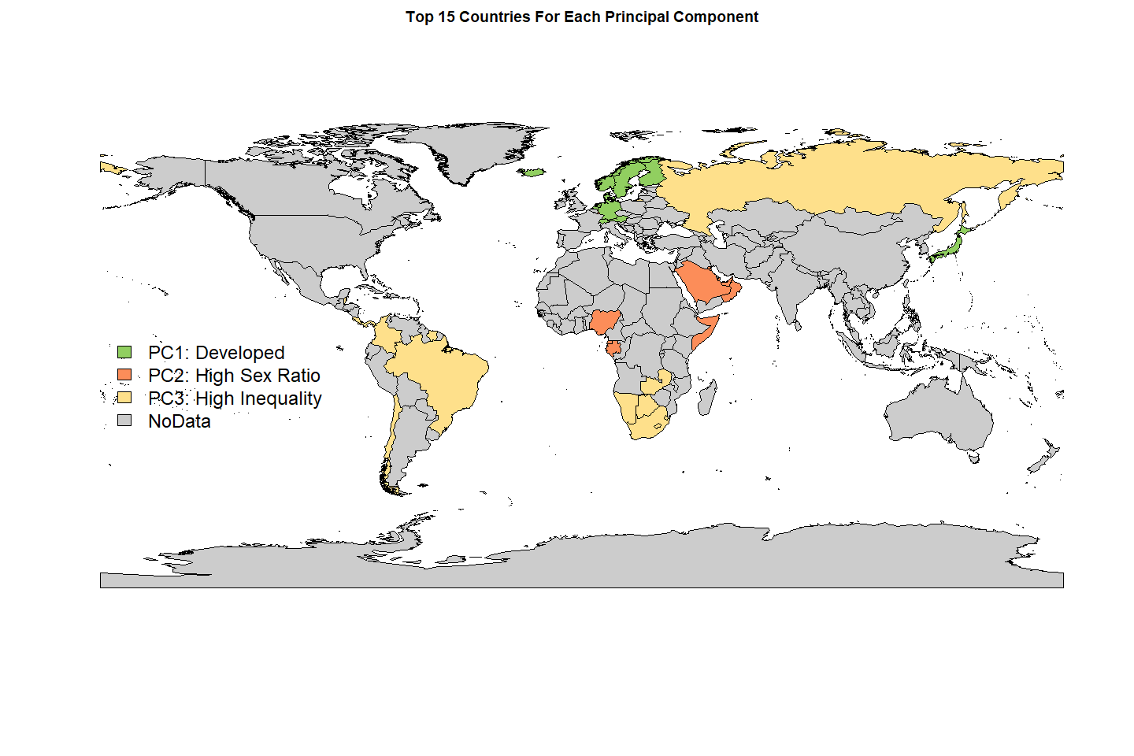
Principal Components on the Map

Slide 10
Part II.
Clusters

Slide 11
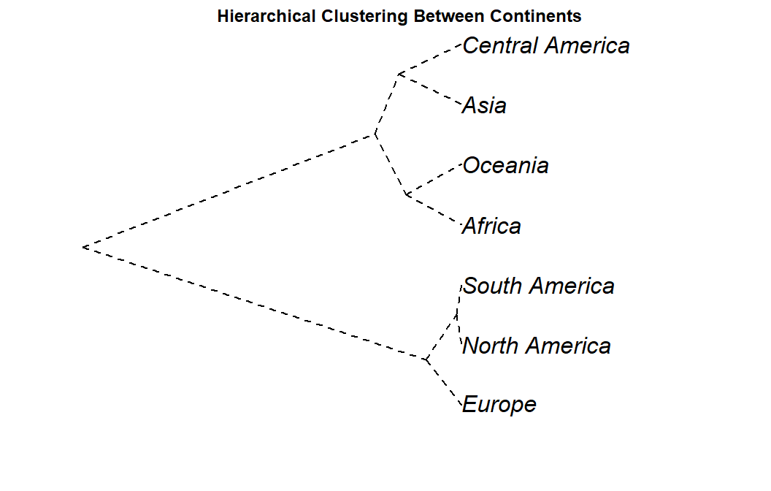
Distances between columns

Slide 12
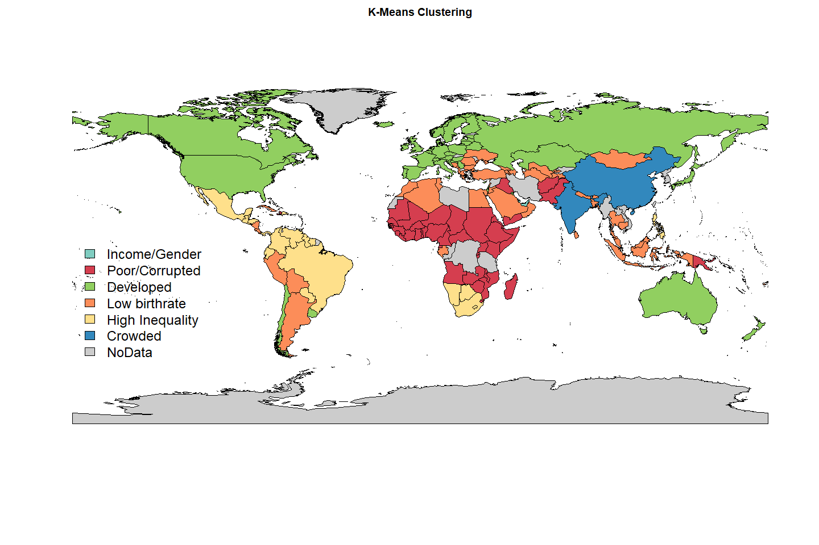
B. Distances between rows

Slide 13
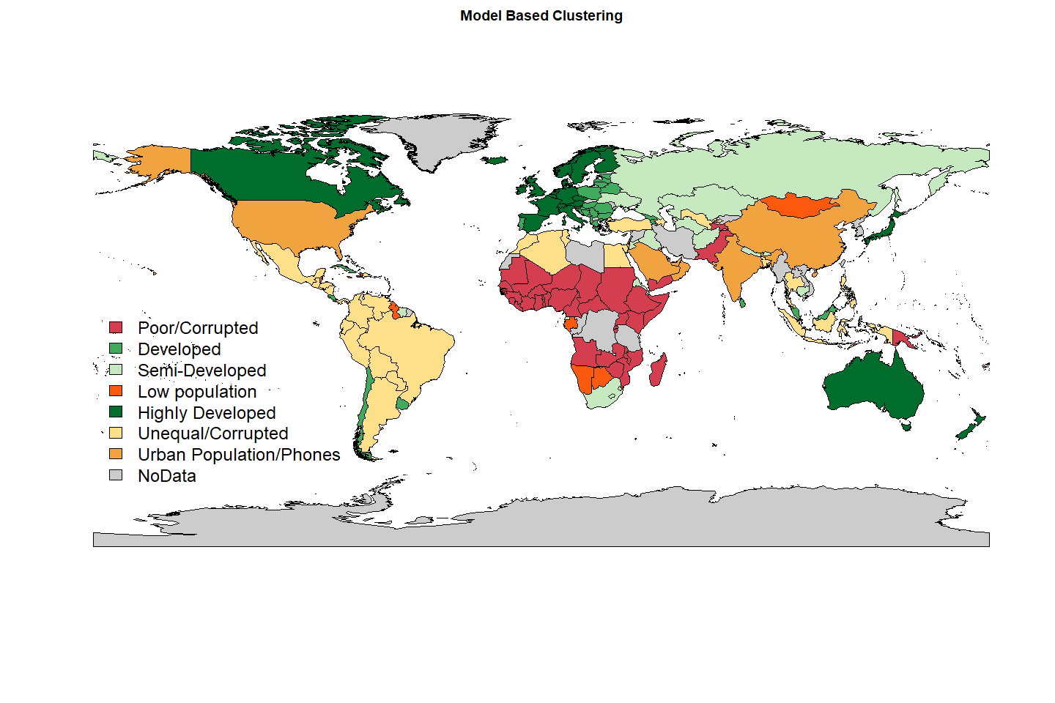
B. Distances between rows

Slide 14
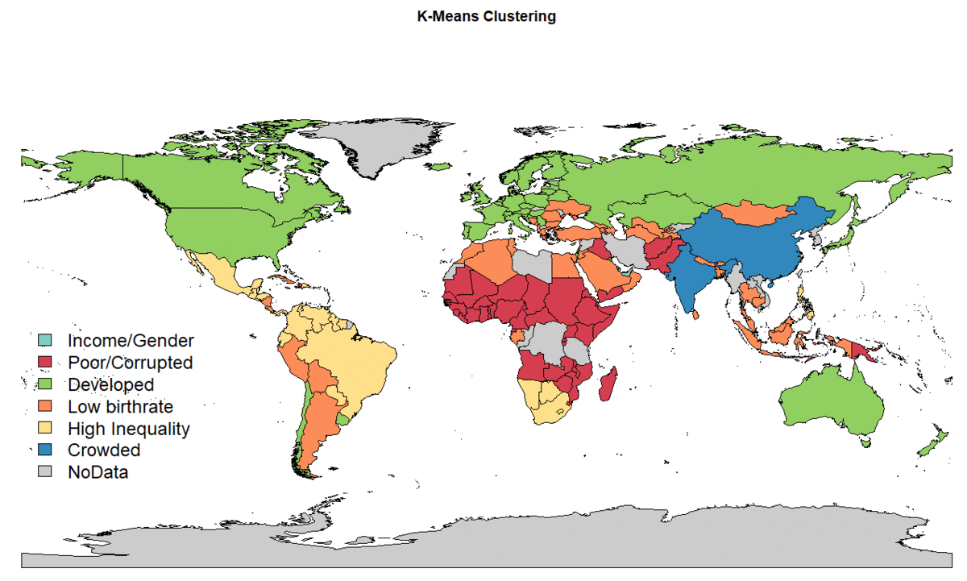
Comparison

Slide 15
Part III.
Exploratory Factor Analysis (EFA)

Slide 16
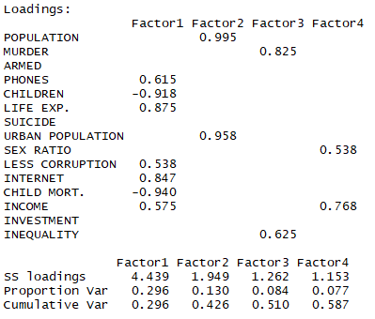
Exploratory Factor Analysis

Slide 17
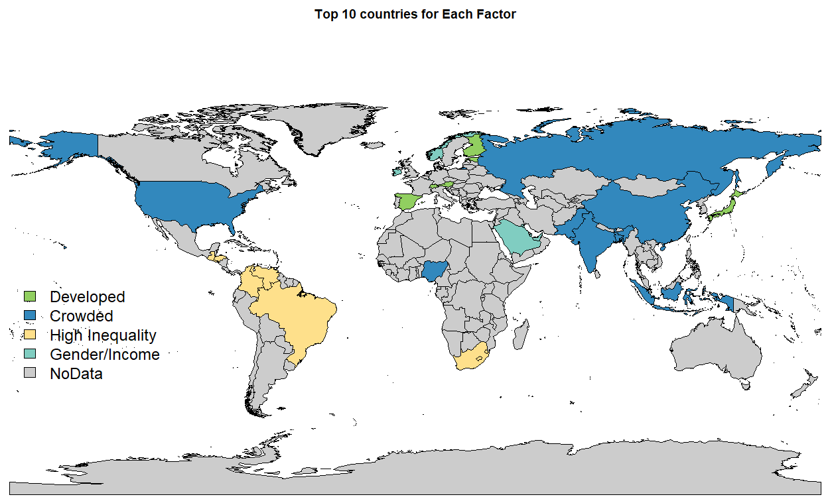
EFA on the Map

Slide 18
Confirmatory Factor Analysis
4 Factors
sem: Algorithm did not converge: Iteration limit exceeded.
lavaan: Large variances
3 Factors (RMSE= 0.029) : not found solution
2 Factors (RMSE=0.058) Model Chi-square = 131.3475 Df = 19 Pr(>Chisq) = 8.101801e-19 ; Goodness-of-fit index = 0.8387516; Adjusted goodness-of-fit index = 0.6944767; SRMR = 0.05365541

Slide 19
Questions
Mikaela Pisani, Marcin Grzechowiak, Jereamy Riggs, Rogelio Valdez

